Slide 1
Natural Language Processing: Sentiment Analysis
Sasha Lawson

Slide 2
What is Natural language processing?
Natural Language Processing (NLP) is a branch of A.I. focused on processing and interpreting the human language
NLP utilizes such tactics as…
Tokenization – Breaking up text into smaller, more manageable, units
“There goes the long red fire truck” to “There goes”, “long red”, “fire truck”
Lemmatization/Stemming – Reducing words to their root
Adding to add
Parsing – Connecting pieces of a sentence to their grammatical type
Nouns, verbs, objects, etc...
Stop Word Removal – The removal of very common words that don’t add value to the sentence’s sentiment
The, a, and, like, etc
Lutkevich, B., & Burns, E. (2023, January 20). What is natural language processing? an introduction to NLP. Enterprise AI. Retrieved April 30, 2023, from https://www.techtarget.com/searchenterpriseai/definition/natural-language-processing-NLP

Slide 3
What can NLP Achieve?
NLP can be utilized to…
Text Summary & Extraction
Taking paragraphs of text and pulling out key information or words
Language Generation & Completion
Sentence or phrase completion based on some type of trained text (corpus)
Text Classification
Classify text into a certain category
> Sentiment Analysis
Lutkevich, B., & Burns, E. (2023, January 20). What is natural language processing? an introduction to NLP. Enterprise AI. Retrieved April 30, 2023, from https://www.techtarget.com/searchenterpriseai/definition/natural-language-processing-NLP

Slide 4


Deep dive into sentiment analysis
Sentiment Analysis helps determine the emotion of a piece of text
Useful & used for…
Review & Survey Analysis
Open responses can be difficult to quickly determine emotion
Tweet Analysis
Creates an interesting challenge as the internet has its own ever-changing language

Slide 5
Relating to Learned Content in Class
Week 4: Data Analysis
Sentiment Analysis helps breakdown complex data into classifications
Can easily be turned into a graphic
Week 6: Supervised
Sentiment Analysis utilizes supervised methods to train their models
Requires labelled data to be trained

Slide 6
Technique and Methods
Machine Learning
Trained on X dataset with Y sentiments; tested on a separate dataset
Lexicon-Based
Utilizing a group of words/phrases commonly associated with positive and negative emotions
“Hate” > Negative, “Love” > Positive
Hybrid
What is sentiment analysis? Examples &amp; Best Practices. CallMiner. (n.d.). Retrieved April 30, 2023, from https://callminer.com/blog/sentiment-analysis-examples-best-practices?utm_campaign=search-us-nonbrand&amp;utm_source=adwords&amp;utm_medium=ppc&amp;ad=652222676346&amp;device=c&amp;matchtype=p&amp;utm_term=sentiment+data&amp;gad=1&amp;gclid=CjwKCAjwo7iiBhAEEiwAsIxQEQ05AZ_wJBt07tDJfOkoRWsWjInCQWiUBiDecVWqBgpQSyWbGIZTChoCWz4QAvD_BwE

Slide 7
Dataset Info & warnings
Twitter dataset full of tweets
74,682 rows
Originally used for machine learning approach
Crude language
Real-world datasets tend to be unfiltered
Found @ Kaggle: https://www.kaggle.com/datasets/jp797498e/twitter-entity-sentiment-analysis/code?resource=download

Slide 8
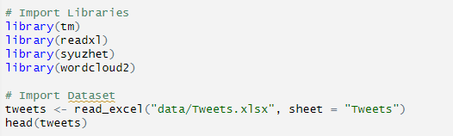
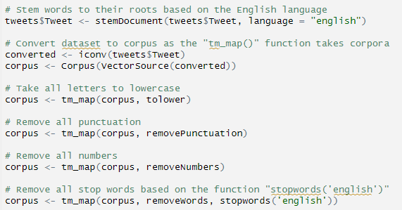
Coding – Preprocessing
Import libraries & dataset
Stem words to their root
Convert to a corpus
Make all letters lowercase
Remove…
Punctuation
Numbers
Stop Words
Sentiment analysis in R: R-bloggers. R-bloggers. (n.d.). Retrieved April 30, 2023, from https://www.r-bloggers.com/2021/05/sentiment-analysis-in-r-3

Slide 9

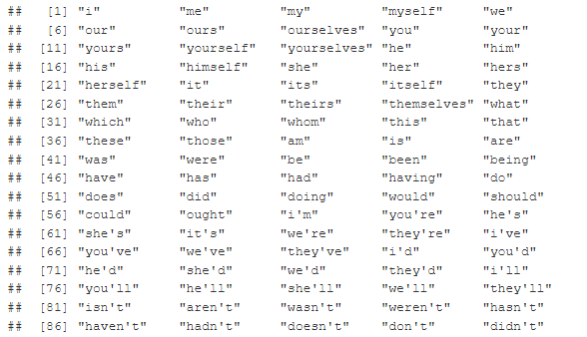
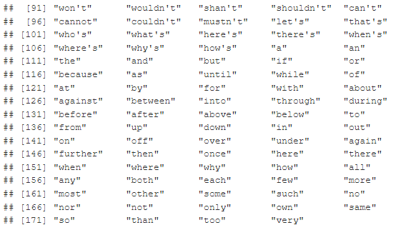
Stop Words Example

Slide 10
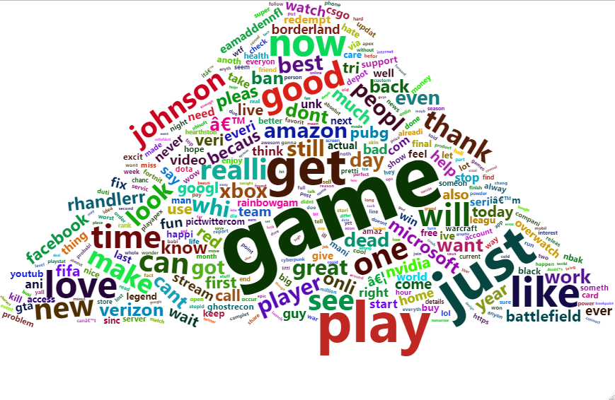
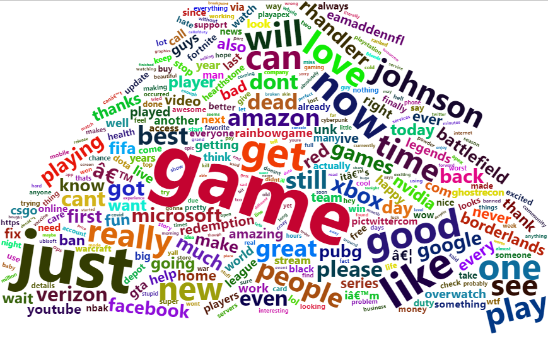
corpus of words
Stemmed
Clean corpus shown via Word Cloud
Tweets and the internet tend not to be kind
Pros & Cons of Stemming
Not Stemmed
Sentiment analysis in R: R-bloggers. R-bloggers. (n.d.). Retrieved April 30, 2023, from https://www.r-bloggers.com/2021/05/sentiment-analysis-in-r-3

Slide 11

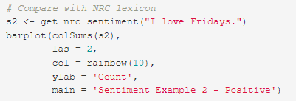
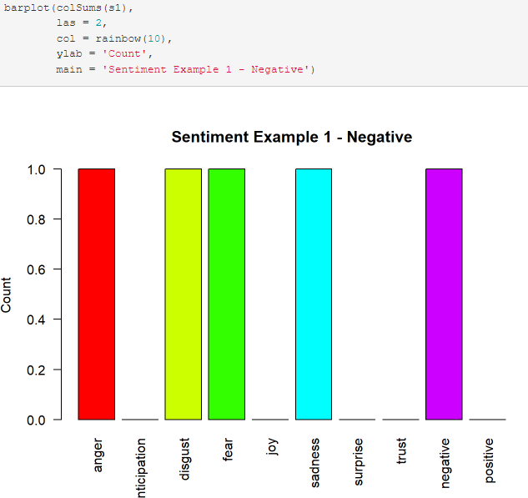
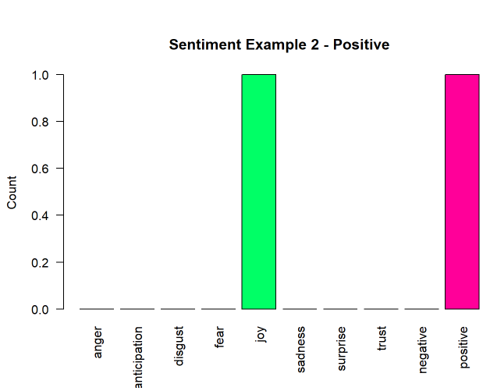
Lexicon – Based
Uses NRC lexicon
Focuses on range of emotions
What’s happening?
Takes corpus and compares with NRC lexicon to determine emotions associated
Sentiment analysis in R: R-bloggers. R-bloggers. (n.d.). Retrieved April 30, 2023, from https://www.r-bloggers.com/2021/05/sentiment-analysis-in-r-3

Slide 12
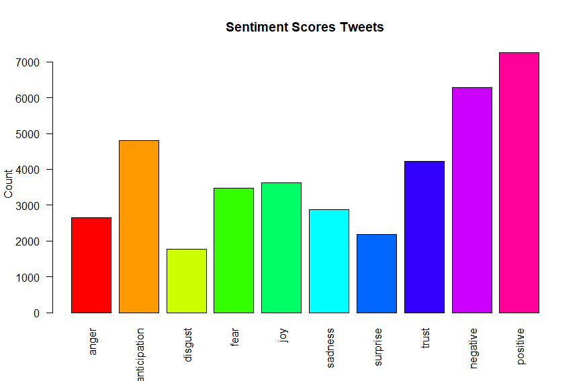
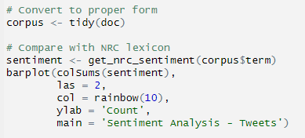
Lexicon – Based Output
Sentiment Analysis - Tweets
Data Centric Inc. (2022). YouTube. Retrieved April 30, 2023, from https://www.youtube.com/watch?v=c7YSyCofH3o&t=695s&ab_channel=DataCentricInc.

Slide 13
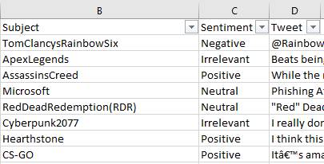
Various complications
Takes a long time to run with a large dataset
Sentence can’t just be defined by just one or two words
“I hate going there” > Negative VS “I’d hate to not go there” > Positive
Language isn’t always consistent in one corpus
SOLUTION: Machine Learning approach, clean dataset more

Slide 14
Future Work and Recommendations
Future Work
Implement into my job
Engagement surveys & employee reviews
Try on more complex dataset?
Recommendations
Spend more time cleaning dataset in preprocessing

Slide 15
Conclusion Summary
Natural Language Processing (NLP) is a branch of A.I. focused on processing and interpreting the human language
Sentiment Analysis helps determine the emotion of a piece of text
Useful & used for review & survey analysis
Machine Learning & Lexicon-Based approaches
Complications depending on the complexity of the corpus

Slide 16
Work Cited
Data Centric Inc. (2022). YouTube. Retrieved April 30, 2023, from https://www.youtube.com/watch?v=c7YSyCofH3o&t=695s&ab_channel=DataCentricInc.
Lutkevich, B., & Burns, E. (2023, January 20). What is natural language processing? an introduction to NLP. Enterprise AI. Retrieved April 30, 2023, from https://www.techtarget.com/searchenterpriseai/definition/natural-language-processing-NLP
Sentiment analysis in R: R-bloggers. R-bloggers. (n.d.). Retrieved April 30, 2023, from https://www.r-bloggers.com/2021/05/sentiment-analysis-in-r-3
What is sentiment analysis? Examples & Best Practices. CallMiner. (n.d.). Retrieved April 30, 2023, from https://callminer.com/blog/sentiment-analysis-examples-best-practices?utm_campaign=search-us-nonbrand&utm_source=adwords&utm_medium=ppc&ad=652222676346&device=c&matchtype=p&utm_term=sentiment+data&gad=1&gclid=CjwKCAjwo7iiBhAEEiwAsIxQEQ05AZ_wJBt07tDJfOkoRWsWjInCQWiUBiDecVWqBgpQSyWbGIZTChoCWz4QAvD_BwE

